Slide 1


Comparison studies on safety and efficacy different generations of recombinant products
Alfonso Iorio
Parsian Azadi Hotel-Tehran-Iran , October 23th 2014

Slide 2

Alfonso Iorio
Associate Professor, Clinical Epidemiology & Biostatistics and Medicine, McMaster University
Director, Adult Hemophilia Centre, Hamilton
Chair, Health Information Research Unit, McMaster University
Co-founder Italian Registry for Congenital Coagulopathies;
Chair, Data and Demographics Committee, WFH
Chair Canadian Hemophilia Registry Program
Associate Editor: Blood Coagulation Disorders of the Cystic Fibrosis and Genetic Disorders Review Group of the Cochrane Collaboration

Slide 3
References
Iorio, A. CDRS, 9, CD003429
Iorio A. Haemophilia, 2014 doi:10.1111/hae.12480
Fischer, K. Blood, 2013: 122(7), 1129–36.
Xi, M. JTH, 2013; 11(9), 1655–62.
Iorio A. JTH 2010;8:1256–65.
Xi, M et al. Journal of Thrombosis and Haemostasis : JTH, 2013; 11(9), 1655–62.

Slide 4
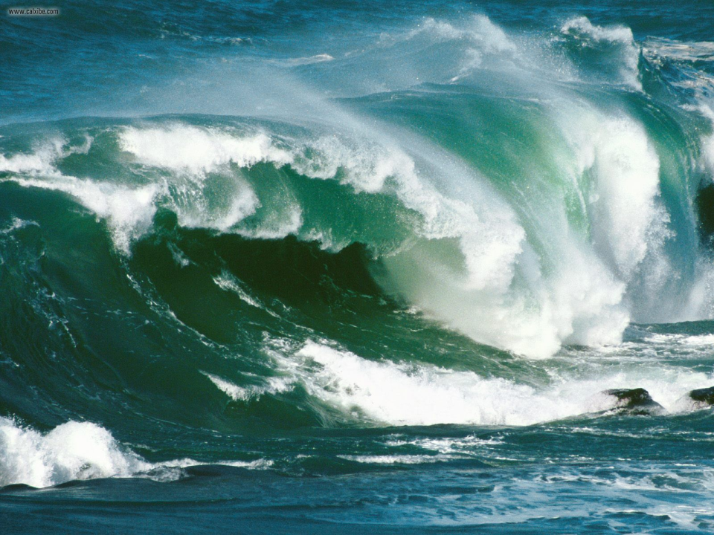
Efficacy

Slide 5
Evidence about efficacy
Level I: Prophylaxis reduces bleeding rate by 10
Cochrane Collaboration SR:
Level II: Higher intensity produces better results
Swedish vs Dutch Regimen
Canadian escalating dose study
Level II: Tailoring to the individual need reduces wastage and costs
Collins
MUSFIT

Slide 6



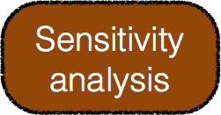


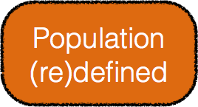
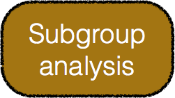
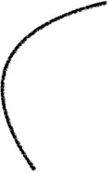

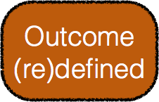


Post Authorization Safety Studies
Iorio A. Haemophilia, 2014 doi:10.1111/hae.12480
Notes:
Inclusion/exclusion criteria of the original PASS studies
Inclusion criteria
Moderate or severe haemophilia A (baseline factor VIII < 5%)
Newly prescribed ADVATE by his/her treating physician
Provided written informed consent, where locally required
Exclusion criteria
Known hypersensitivity to the active substance or to any of the excipients
Known allergic reaction to mouse or hamster proteins

Slide 7
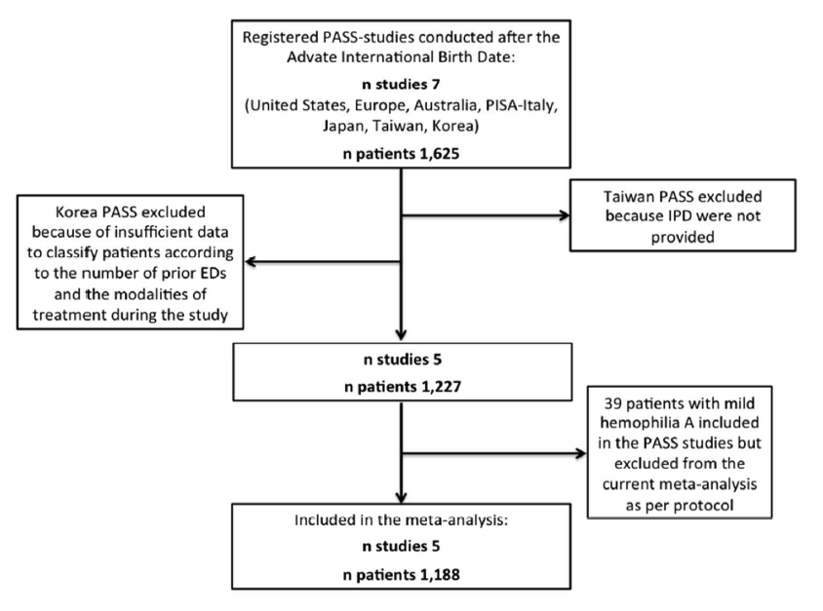
0/43
5/358
Iorio A. Haemophilia, 2014 doi:10.1111/hae.12480

Slide 8
PASS Effectiveness Outcomes
Secondary Analyses | Patient Number | Bleeding Events (patients)
Annualized Bleeding Rate |  | median (Q1, Q3)
All patients | 1,140 | 3.83 (0.60, 12.90)
Patients prescribed OD at enrolment | 421 | 10.38 (2.27, 27.29)
Prophylaxis (on study, any frequency) | 707 | 2.00 (0, 6.73)
Prophylaxis (on study, ≥twice/week) | 560 | 1.67 (0, 4.80)
Iorio A. Haemophilia, 2014 doi:10.1111/hae.12480

Slide 9

Safety

Slide 10
Population
(PUPs vs PTPs)
?
Design and
time
Outcome
(inhibitors)
Notes:
We will analyze the question to assess whether it is important - and whether any answers can be equally important.
The importance of a question is measured by the motivations for asking and and answering it.
What are the underlying motivations here?
Clinical need? Economic implications (tenders?)? Clinician, patients, manufacturers, regulatory agency may have different perspectives
Let’s start by splitting the question in 3 components: population (PUPs and PTPs), outcome (inhibitor development) and intervention/exposure (product type)

Slide 11
PTPs (vs PUPs)
as a model to study immunogenicity
Strenghts
Already tolerized
No other con causes
Easier to recruit
adults
low, if any, risk of events
Weaknesses
..to a specific FVIII
Assumptions!!
Easy and optimal are enemies
Low prevalence
BU? NIAb? threshold?
Notes:
Here we discuss PUPs and PTPs
Why we would use one, or the other or both
Which use we can do of the risk difference measured in one, the other or both
Example of the city car

Slide 12
Characteristics of inhibitors in PTPs
As a result of our systematic review, we identified:
•39 de novo inhibitors reported in 19 publications. Individual patient data has been collected for:
•29 (74%) inhibitor cases overall
•14 (36%) from CRFs completed by study investigators
•15 (39%) extracted from patient-level information available in the published reports.
Notes:
ISTH SSC project on harmonization of reporting of inhibitors in PTPs

Slide 13
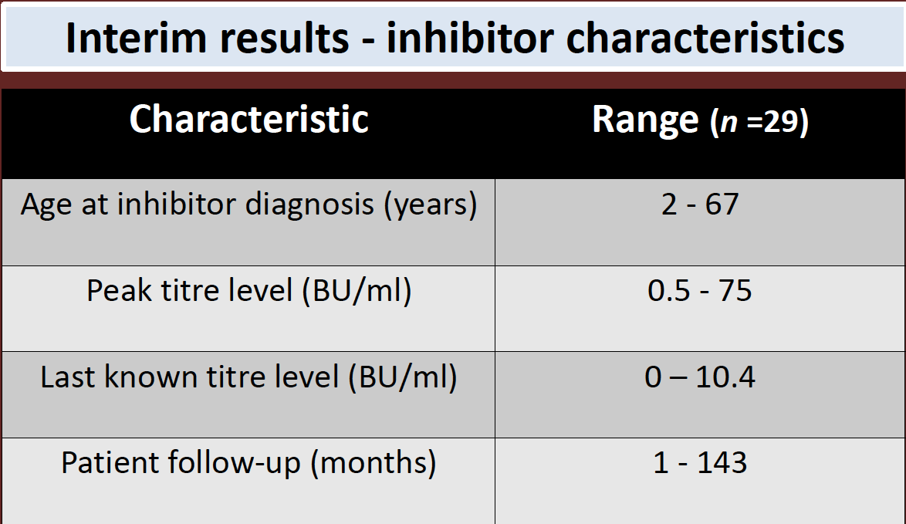

Slide 14
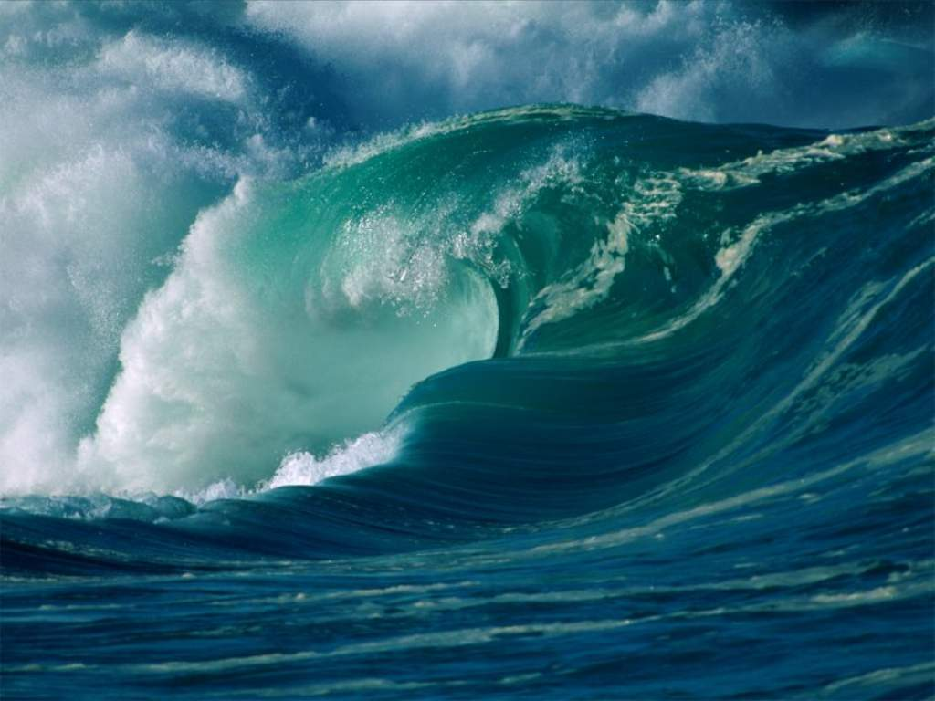
Evidence in PTPs

Slide 15
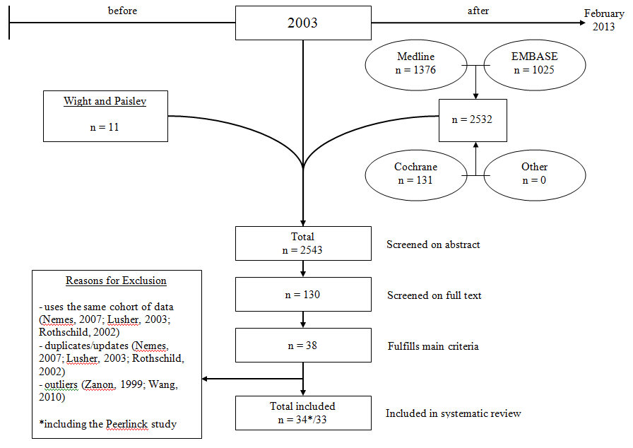
PTP meta-analysis
Xi, M et al. Journal of Thrombosis and Haemostasis : JTH, 2013; 11(9), 1655–62.
Notes:
33 cohorts
4323 subjects
43 incident de novo inhibitors.
Pooled incidence rate 3 (95% CI 1-4)
per 1000 person years.
25 studies providing data on follow-up lenght
No significant risk factors at meta-regression and subgroup analysis.
The model was sensitive to the inclusion of the reports on the Belgian-Dutch experience with a highly immunogenic factor VIII.

Slide 16
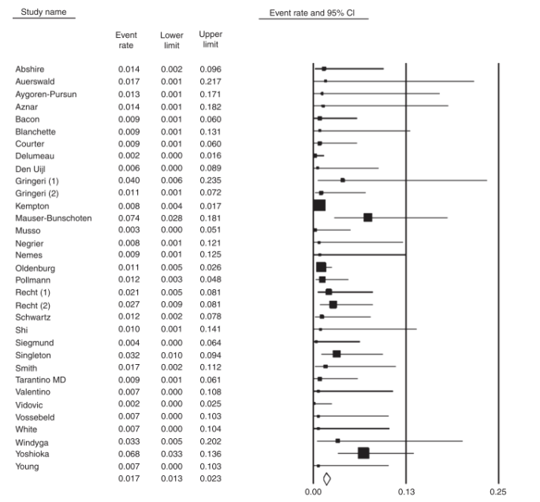
0/29
1/25
1/30
Xi, M et al. Journal of Thrombosis and Haemostasis : JTH, 2013; 11(9), 1655–62.
Notes:
Inclusion criteria: prospective or retrospective studies with follow up of at least 25 patients treated with factor VIII - separate data for PTPs to be available if PUPs included.
43 inhibitors in 4323 subjects
3 x 1000 patient years (1-4)

Slide 17
Inhibitor rates, selected recombinant FVIII
Product | Studies | Rate (x 100 py) | 95% CI
Advate | 9 | 0.10 | 0.05-0.18
Kogenate | 9 | 0.12 | (0.04-0.33)*
Refacto | 8 | 0.19 | 0.11-0.34
PD factor VIII | 4 | 0.09 | 0.02-0.45
* 0.26 (0.16 - 0.44) at fixed effect model
Xi, M et al. Journal of Thrombosis and Haemostasis : JTH, 2013; 11(9), 1655–62.
Notes:
This slide to show the variability and consequent imprecision of estimates for individual molecules; the analysis has to be considered hypothesis generating, and no formal statistical test is possible, being the cohorts completely unrelated.
The effect of adding Peerlink, invoke the importance of full data collection

Slide 18
Sensitivity analysis
Variable | Proportion | Heterogeneity
Design |  | within | between
RCT(4) | 0.012 (0.009-0.041) | Low | P=0.231
Prosp (20) | 0.015 (0.011-0.027) | Low 0.013
Retrosp (8) | 0.019 (0.012-0.030) | Moderate 0.020
Other (3) | 0.010 (0.04-0.029) | Low
Xi, M et al. Journal of Thrombosis and Haemostasis : JTH, 2013; 11(9), 1655–62.

Slide 19
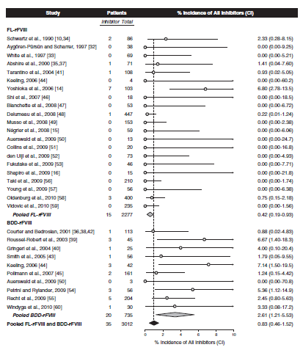
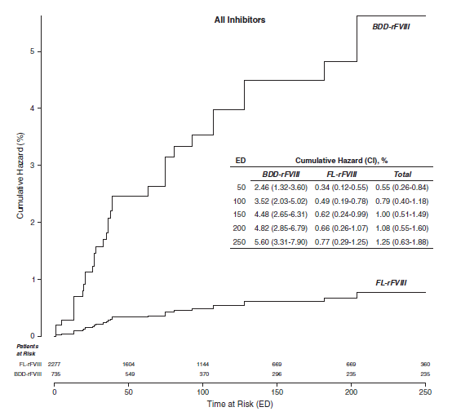
Aledort LM et al. JTH 2011;9:2180–92.
Iorio A et al. JTH 2011;9:2176–9.
Aledort LM et al. JTH 2011;9:2325–7.
Notes:
(22)

Slide 20
Science is built up of facts, as a house is built up of stones; but an accumulation of facts is no more science than a heap of stones is a house
Henri Poncare, 1854–1912
Notes:
French mathematician

Slide 21
The EUHASS study
Strengths
Prospective, very large inception cohort
Controlled (parallel, head-to-head)
Limitations
Minimal information collected
No multivariable approach
Confounding still possible
Dynamic cohort not always at steady-state

Slide 22
EUHASS: Inhibitors in PTPs
Product | Inhibitors | Pt/yr | Rate | (95% C.I.)
1 | 5 | 4656 | 0.11 | (0.03-0.25)
2 | 1 | 1987 | 0.05 | (0.00 - 0.28)
3 | 6 | 3519 | 0.17 | (0.06 - 0.37)
4 | 3 | 2338 | 0.13 | (0.03 - 0.37)
Data from the EUHASS annual reports to the Investigators
Notes:
From Oct 1st, 2008 to Dec 31st, 2012 68 Centers reported 108 inhibitors in 417 PUPs (26%; CI 22-30%) PUPs with severe hemophilia A and 26 inhibitors developed in17,667 treatment years in PTPs.
Clinical inhibitors - safe; denominator: pts or py? switches? cancellation of random errors
is 1in 2000 different from 2 in 1000?

Slide 23
Findings in PTPs
No difference in inhbitor rates between
Plasma derived and recombinants
Different recombinants
When the proper analysis method is used

Slide 24

Evidence in PUPs

Slide 26
..”homogeneous results”
Univariate
Multivariate
Calvez T et al J Thromb Haemost 2008

Slide 27
Inhibitor risk in PUPs: a meta-analysis
Aim of the study
To produce an updated systematic review of the evidence regarding the role of PD versus R factor concentrates in modulating inhibitor incident rate
To investigate the role of study- and patient-level characteristics on the estimated effect
Iorio A et al. JTH 2010;8:1256–65.
Notes:
The novelty of this systematic review relies on the inclusion
of 13 additional trials (including 1468 additional patients)
beyond those included in the systematic review by Wight and
Paisley
We were trying to strenghten the rationale for the SIPPET study

Slide 28
Results
Potentially relevant papers
Potentially relevant papers
identified from electronic
identified from electronic
databases
databases
n=205
STUDY SELECTION
n=205
Additionally identified papers
Additionally identified papers
Papers found after main search
Papers found after main search
from citation/references
from citation/references
n= 4
n= 4
17 pdFVIII cohorts
15 rFVIII cohorts
19 prospective cohorts
13 retrospective cohorts
2094 pts / 420 inhibitors
+13 over Wight and Paisley
n=14
n=14
Total papers retrieved in
Total papers retrieved in
abstract from
abstract from
citations/references
citations/references
n=223
n=223
Papers retrieved in
Papers retrieved in
full text
full text
Reason
Reason
for
for
exclusion
•
exclusion
•
3
3
reviews
reviews
n=36
•
n=36
•
4 unclear kind of exposure
4 unclear kind of exposure
to
to
pdFVIII
pdFVIII
or
or
rFVIII
•
rFVIII
•
1 trial reported only data
1 trial reported only data
about HR
about HR
•
•
2 cumulated data about
2 cumulated data about
Included
Included
studies
PUPs/non
studies
PUPs/non
-
-
PUPs
•
PUPs
•
1 no
1 no
original
original
data
•
data
•
1
1
only
only
two
two
PUPs
PUPs
n=24
n=24
(31
(32
cohorts
cohorts
)
)
Iorio A et al. JTH 2010;8:1256–65.

Slide 29
Pooled Analysis of Single Arm Studies (Pooled incidence rates)
pdFVIII | rFVIII | P value (Cochrane Q)
14.3 (10.4-19.4) | 27.4 (23.6-31.5) | <0.001
Iorio A et al. JTH 2010;8:1256–65.
Notes:
(17)

Slide 30
ANOVA
 | F | Prob > F | Adjusted R²
Univariable Models
kind of concentrate | 17.51 | 0.0002 | 0.35
study design | 7.96 | 0.0248
Multivariable Model
MODEL | 7.26 | 0.0123 | 0.80
kind of concentrate | 0.26 | 0.6287
study design | 0.08 | 0.7903
kind of conc*test freq | 0.41 | 0.5445
Kind* of conc*study period | 0.25 | 0.6355
Kind of conc*FUP | 0.93 | 0.3721
study design * test freq | 2.75 | 0.1485
study design * study period | 0.08 | 0.7914
study design * FUP | - | -
Iorio A et al. JTH 2010;8:1256–65.
Notes:
The systematic review demonstrates that rFVIII products were associated with a higher incidence rate of inhibitor development than pdFVIII.
The effect of the kind of concentrate became less important when high responders or non-transient inhibitors were analyzed.
In multivariable analysis a significant proportion of the variability observed in inhibitor detection rate between pd and rFVIII was explained by some patient and study characteristics (inhibitor testing frequency, study period, follow-up duration).
LIMITS
Observational studies included
methodological differences (survival analysis not made)
insufficient reporting
Source of FVIII switching issue
Uncontrolled risk factors (intensity and modality of treatment, trigger events)

Slide 31
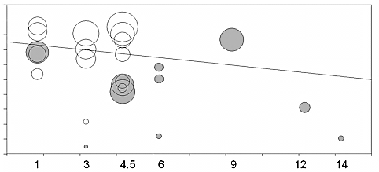
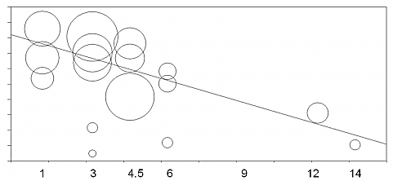
Meta-regression
a) Testing frequency (months)
White = rFVIII
Grey = pdFVIII
b) Testing frequency (months)
Only prospective studies
Y-axis shows the logit of the incidence rate of inhibitor. Each bubble represents a single study, the diameter being inversely proportional to the variance of the study.
Iorio A et al. JTH 2010;8:1256–65.
Notes:
(19)

Slide 32
EAHAD COLLABORATIVE GROUP ON TREATMENT RELATED INHIBITOR RISK
Predictors of inhibitor development in Hemophilia A previously untreated patients: the role of factor concentrate type.
An individual patient data meta-analysis.
Iorio A et al. WFH 2012, Paris, Submitted
Notes:
Investigate the role of
- removable patient (level) attributes as risk factors for inhibitors
- different analytical techniques

Slide 33
Study design
Pooled cohort of consecutive patients from 6 Hemophilia Centres (5 European, 1 Israeli)
284 PUPs born between 1967 and 2011
Moderate-Severe¹ Hemophilia A
Treated with pdFVIII or rFVIII concentrates, with high-dose² or low-dose regimen
Followed up until =>200 ED
¹Baseline FVIII level ≤ 0.05 IU/dl
²Median single dose received within 8 to 12 weeks after therapy start > 30 IU/kg of body weight

Slide 34
Study methods
Cox regression analysis
CART
Propensity score matching
To adjust a Cox model
To calculate the Average effect of Treatment on the Treated (ATT)

Slide 35
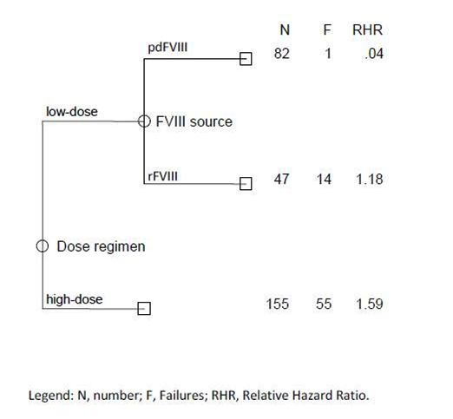
Classification and Regression Tree (CART)
Variables included :
FVIII source
dose regimen

Slide 36
Unpublished data omitted
Analysis results did show that, when adjusting for covariates, there is no difference between plasma derived and recombinant
Paper submitted to Thrombosis and Haemstasis

Slide 37
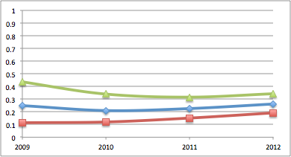
Inhibitors in PUPs (rate and 95% CI)
Inhibitors (proportion)
Time (yr)
8 | 12 | 24 | 37
32 | 56 | 106 | 141
Cases
At risk
Data from the EUHASS annual reports to the Investigators

Slide 38
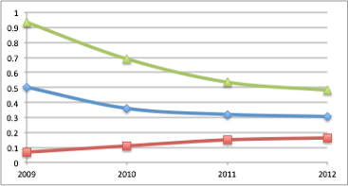
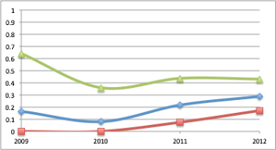
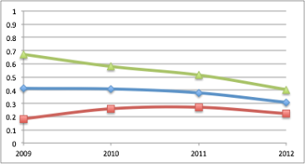
8 | 12 | 24 | 37
32 | 56 | 106 | 141
1 | 1 | 5 | 15
6 | 13 | 23 | 52
2 | 4 | 8 | 11
4 | 11 | 25 | 36
7 | 17 | 26 | 33
17 | 41 | 67 | 107
Data from the EUHASS annual reports to the Investigators

Slide 39
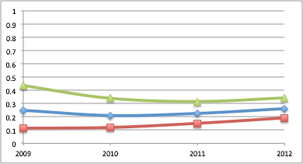
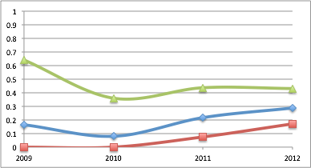
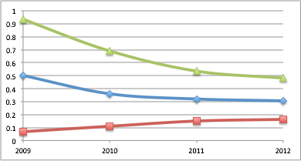
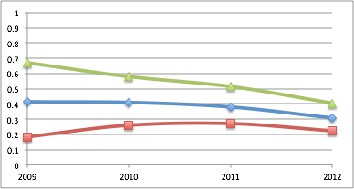
Year | 2009 | 2010 | 2011 | 2012
Inhib | 8 | 34 | 63 | 96
Exposed | 59 | 121 | 221 | 336
Proportion | 0.31 | 0.28 | 0.29 | 0.29
Data from the EUHASS annual reports to the Investigators
Notes:
The overall rate did not change - the figure is slightly different from the one of the final analysis, because this are non validated data. Data for individual studies converged. This suggests cancelling of random errors in the initial estimates. Also, it looks like PUPs are not so bad to this scope..

Slide 40
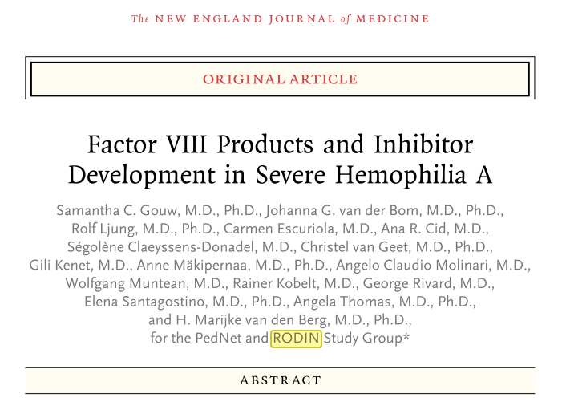

Slide 41
The RODIN study
Strengths
Naturalistic, large
Controlled (parallel, head-to-head)
Very high data quality
Weaknesses
Residual confounding
Intrinsic to the design
Analytical approach
Notes:
Extremely rich dataset to be mined
574 consecutive patients with severe hemophilia A (factor VIII activity, <0.01 IU per milliliter) who were born between 2000 and 2010 and collected data on all clotting-factor administration for up to 75 exposure days. The primary outcome was inhibitor development, which was defined as at least two positive inhibitor tests with decreased in vivo recovery of factor VIII levels.

Slide 42
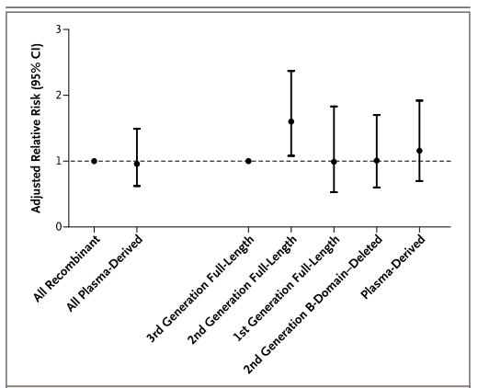
Gouw, SC et al. The New England Journal of Medicine, 368(3), 231–9.

Slide 43
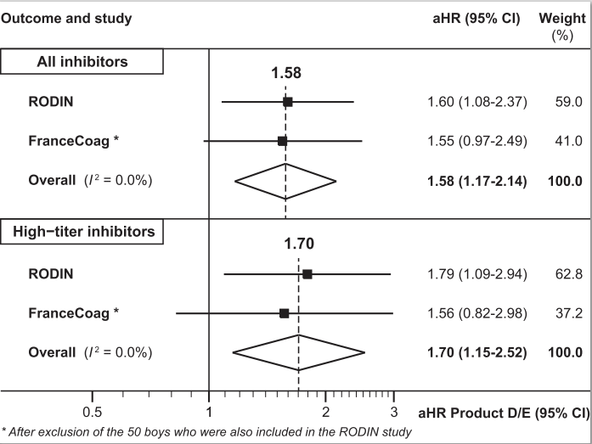

Slide 44
Unpublished data omitted
Sensitivity analysis of the French data show that all the effect is due to 3 centers
These were those observing low inhbitor rate with Kogenate in the early 2000, and likely selected high risk patients to be treated with kogenate

Slide 45



Inhibitor incidence per protocol
19 subjects dosed
9 subjects with suspected FVIII inhibitor
1 not confirmed FVIII inhibitor
8 subjects (42.1%) with confirmed FVIII inhibitor
5 high titer (26.3%) FVIII inhibitors (> 5 BU/ml)
3 low titer (15.8%) FVIII inhibitors
(≥ 0.6 and ≤ 5 BU/ml)
Courtesy of Guenter Auesrwald: ASH, New Orleans, 2013.
Notes:
subj inhib inhib + Ab
PUPs 11 (57.9) 4 (36.4) 3 (27.3)
MTPs 8 (42.1) 4 (50.0) 3 (37.5)
Total 19 (100) 8 (42.1) 6 (31.6)
CSR, 11.3.1.1 Primary Endpoint
Two of the subjects initially classified as low-titer Bethesda confirmed inhibitors based on their first positive inhibitor result, subsequently converted to high titer inhibitors after having been withdrawn from the treatment regimen (subjects 610001 and 710001).
Subject 610001 had a FVIII inhibitor detected at his ED 6 visit (1.5 BU/ml), confirmed at ED 8, 4.7 BU/ml). At his termination visit (approximately 4 weeks later) his inhibitor titer was 6.3 BU/ml. At a follow-up visit approximately 4 months after initial inhibitor
detection (Month 3 Observational Visit) his titer was 11.4 BU/ml
Follow-up information on subject 610001 including successful ITI treatment outcome is published in
Moorehead et al, poster presentation at ISTH 2013
Subject 710001 had a PICC line inserted in the right arm at ED 17 to the IP. This
intervention took place after the subject was withdrawn from further treatment with IP,
due to a confirmed positive FVIII inhibitor result (1.1 BU on ED 15 Visit, 02-Oct-2012),
and became necessary while the subject was hospitalized for a hemorrhage in the left
Forearm.
The subject’s study termination visit (16 Nov 2012) was delayed due to events occurring around
Hurricane Sandy (29 Oct 2012) and was thus performed after the surgery.
Subject 710001 had a FVIII inhibitor detected at his ED 15 visit (1.1 BU/ml). At the termination visit (6.5 weeks after first inhibitor
detection) his inhibitor titer was 24.4 BU/ml.

Slide 46
Role of concentrate type: PUPs
Not any important difference
suggested by assessment of
the overall body of evidence
Notes:
As of February 2014, we have no evidence for a difference among concentrates.
Relevance to clinical decisions / relevance to tenders
Safest and unaffordable, safe and affordable, bear a risk and be treated, cripple your joint without inhibitors

Slide 47
Summary .1
The risk of inhibitors associated with treatment (source / dose)
Cannot be estimated from observational studies without accounting for the effect of confounders
The interaction between the candidate predictor and the confounders should always be tested

Slide 48
Summary .2
The risk of inhibitors associated with treatment (source / dose)
Might benefit from use of sophisticated statistical analysis tecniques, eg propensity score analysis
This might:
Increase consistency of evidence from imperfect observation
Help in better planning future studies

Slide 49




Thank You iorioa@mcmaster.ca hemophilia.mcmaster.ca

